Slide 1
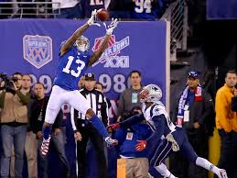
Future NFL Football Player
By: Amarion Clayborn

Slide 2
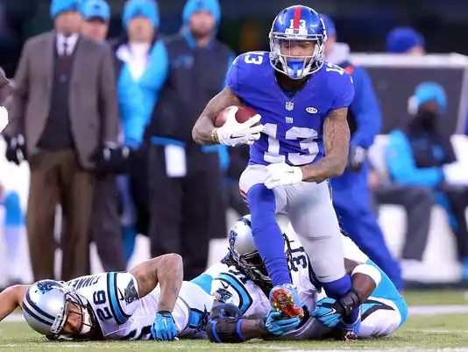
Responsibilities
Plays sports games
Exercises and practices
Is part of a team

Slide 3
Working Conditions
Practices outdoors for many sports
Some indoors
Have games every week

Slide 4
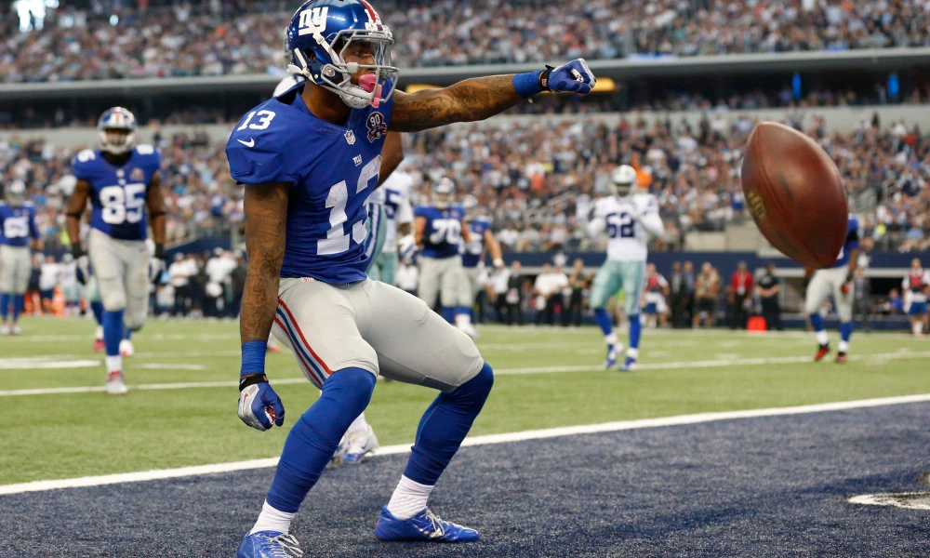
Education and Training
Physical Education
Health class
Most pro’s have a bachelor degree
Few pro’s are required out of school

Slide 5
Earnings
I will make 3.6 billion Dollars in the NFL.

Slide 6
Conclusion
I still want to play in the NFL player because you get payed a lot and there are great condition and education and skill.

Slide 7
Sources Virginia Career VIEW

