Slide 1
A Future Lawyer
Martiana Page

Slide 2
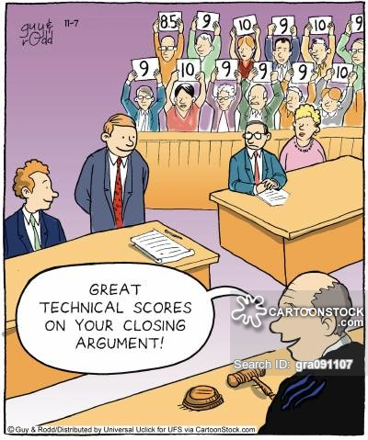
Responsibilities
Interview people
Do research to find out facts
Write legal documents like contracts and wills

Slide 3
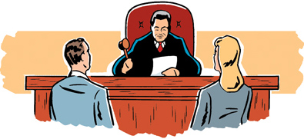
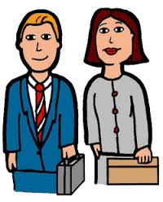
Working Conditions
Offices
Libraries
Work in the courtrooms

Slide 4
Education and Training
Bachelor’s degree is usually required.
Lawyers also have a degree called ’’juris doctorate which means’’ doctor of law.
All lawyers need a License from the test called the bar examination.

Slide 5
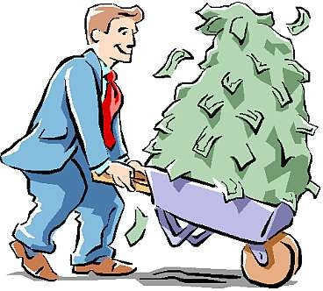
Earnings
Lawyers make average of 163,020

Slide 6
Conclusion
Yes, I Would like this job because lawyers get paid a lot.
Yes, I would like this job to help people solve their problems.

Slide 7
Sources
“Lawyer.” Virginia Career VIEW. Virginia Career VIEW. November 30,2016. http://www.vacareerview.org/K5/check-it/kids-search/occupation.cfm?id=54

